Slide 1
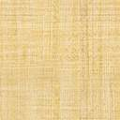
INSTRUCTIONS
Knapsack Optimisation Task
Summary. You will be asked to solve 18 instances of the so-called knapsack optimisation problem. The knapsack problem is a puzzle where a knapsack needs to be filled with a selection from among a number of items. The aim is to find the most valuable set of items, given a weight constraint. You will be compensated for your efforts, as follows. For every right answer you will receive $1.
Background. This experiment is part of a study exploring human problem solving when problems are hard – even for modern computers. We hope not only to understand how humans approach such problems, but also to develop tools for improved human decision making.

Slide 2
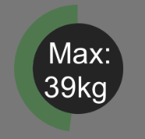
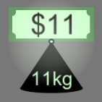
The Task
You will be asked to solve several instances of a computer game based on the knapsack optimisation problem. This task is very similar to the one you previously played. This time, your goal is to maximize the total value (sum of values) of the items that can fit into the knapsack.
The centre of the screen will now only show the weight constraint. You are asked to pick those items that maximise the total value and whose total weight (sum of weights) is less than the weight constraint.
To select an item you need to click on it. A chosen item will be highlighted.
If later on you want to change your mind and remove an item from the knapsack, just click on the item again.

Slide 3
The Task
You can submit your choice of a knapsack composition by pressing D.
You CAN submit your answer before time is up.
If the time runs out, the items that were currently selected just before the time ran out will be submitted as your answer for that round.

Slide 4

Example
The video shows a standard (speeded-up) round where the player selects and deselects some of the items.
The explicit question here is whether you can pick those items that maximize the total value and whose sum of weights is at most 35kg. In this case an answer is chosen in the end and the player submits his/her answer before the time is over.

Slide 5

Compensation
For this part of the task you will earn $1 for each instance solved correctly.

